Slide 1
Software Security Fundamentals-SAMM
Software Assurance Maturity Model (SAMM) developed by OWASP
A guide to building security into software development
96 page PDF
http://www.opensamm.org/downloads/SAMM-1.0.pdf

Slide 2

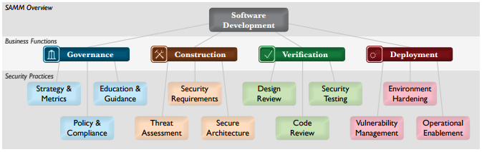
Software Security Fundamentals-SAMM

Slide 3
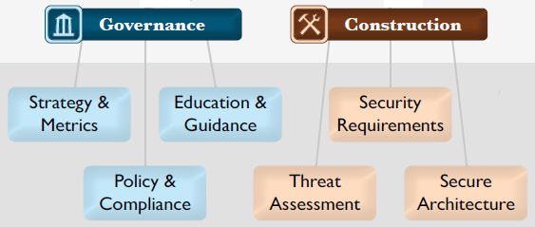
Software Security Fundamentals-SAMM

Slide 4
Software Security Fundamentals-SAMM
OWASP Software Assurance Maturity Model (SAMM) Governance Phase:
Strategy & Metrics
Education & Guidance
Policy & Compliance

Slide 5
Software Security Fundamentals-SAMM
Strategy & Metrics:
Focused on establishing the framework within an organization for a software security assurance program.

Slide 6
Software Security Fundamentals-SAMM
Strategy & Metrics:
…This is the most fundamental step in defining security goals in a way that’s both measurable and aligned with the organization’s real business risk.

Slide 7
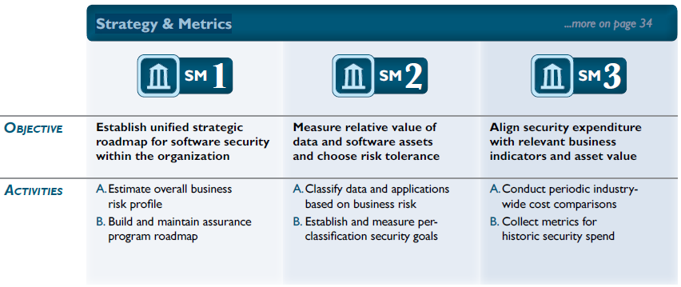
Software Security Fundamentals-SAMM

Slide 8
Software Security Fundamentals-SAMM
Education & Guidance:
Focused on arming personnel involved in the software lifecycle with knowledge and resources to design, develop, and deploy secure software

Slide 9
Software Security Fundamentals-SAMM
Education & Guidance:
…With improved access to information, project teams will be better able to proactively identify and mitigate the specific security risks that apply to their organization.

Slide 10
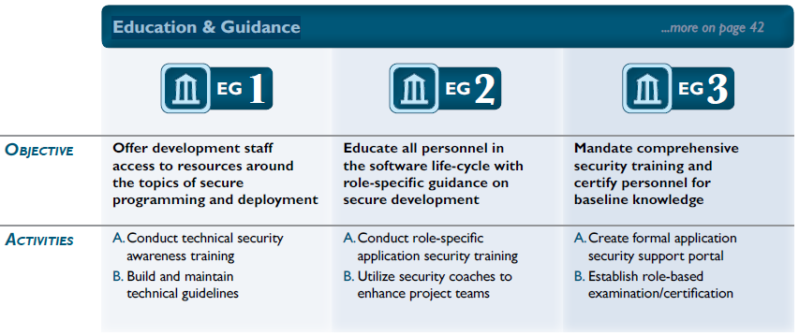
Software Security Fundamentals-SAMM

Slide 11
Software Security Fundamentals-SAMM
Policy & Compliance:
Focused on understanding and meeting external legal and regulatory requirements while also driving internal security standards to ensure compliance in a way that’s aligned with the business purpose of the org.

Slide 12
Software Security Fundamentals-SAMM
Policy & Compliance:
A driving theme for improvement within this Practice is focus on project-level audits that gather information about the organization’s behavior in order to check that expectations are being met.

Slide 13
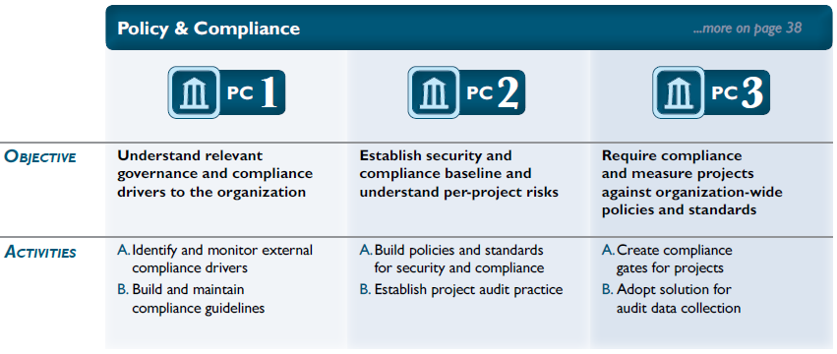
Software Security Fundamentals-SAMM

Slide 14
Software Security Fundamentals-SAMM
Lets look at SAMM Construction Phase in the next module…
END

